Slide 1
Business Analytics Linear Regression

Slide 2

What is Regression??
It’s a relationship!!

Slide 3
Find the missing number..!!
1, 4, 9, 16, 25, ??, 49

Slide 4

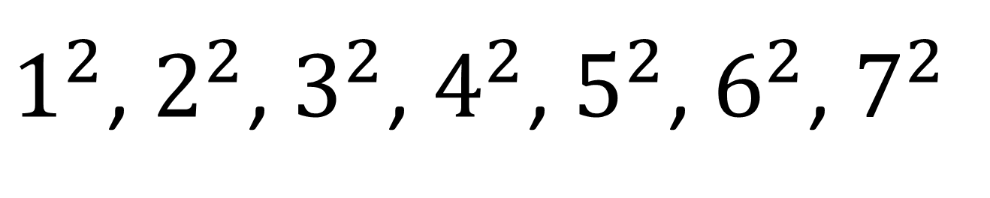
1, 4, 9, 16, 25, ??, 49

Slide 5
How much will be the sales..??
Advertisement | Sales
5 | 62
10 | 100
16 | 148
30 | 300
33 | 357
40 | 400
5 | 700
20 | ? ? ? ? ? ?

Slide 6








Plot the sales on a graph..!!
Advertisement
Sales

Slide 7
Join the points with a line.. A curve maybe!!
Advertisement
Sales

Slide 8
Has to be a straight line.. But which line..!!
Advertisement
Sales

Slide 9
Called residuals and not deviations in regression.. Least Square Method
Advertisement
Sales

Slide 10
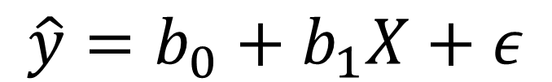
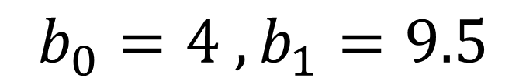
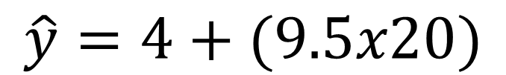
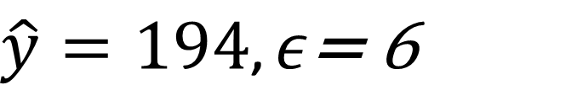

Regression Equation..!!
Advertisement
Outlier
Sales

Slide 11
Multiple Linear Regression..!!
Sales = price_own + price_comp + prom1 + prom2 + promn + ....seasonality + error

Slide 12
Dummy Variable..!!
It is an artificial variable.
Why should I need it???

Slide 13
Model Validation..!!
ANOVA
R Square
Adjusted R Square
P value
AVP
MAPE

Slide 14

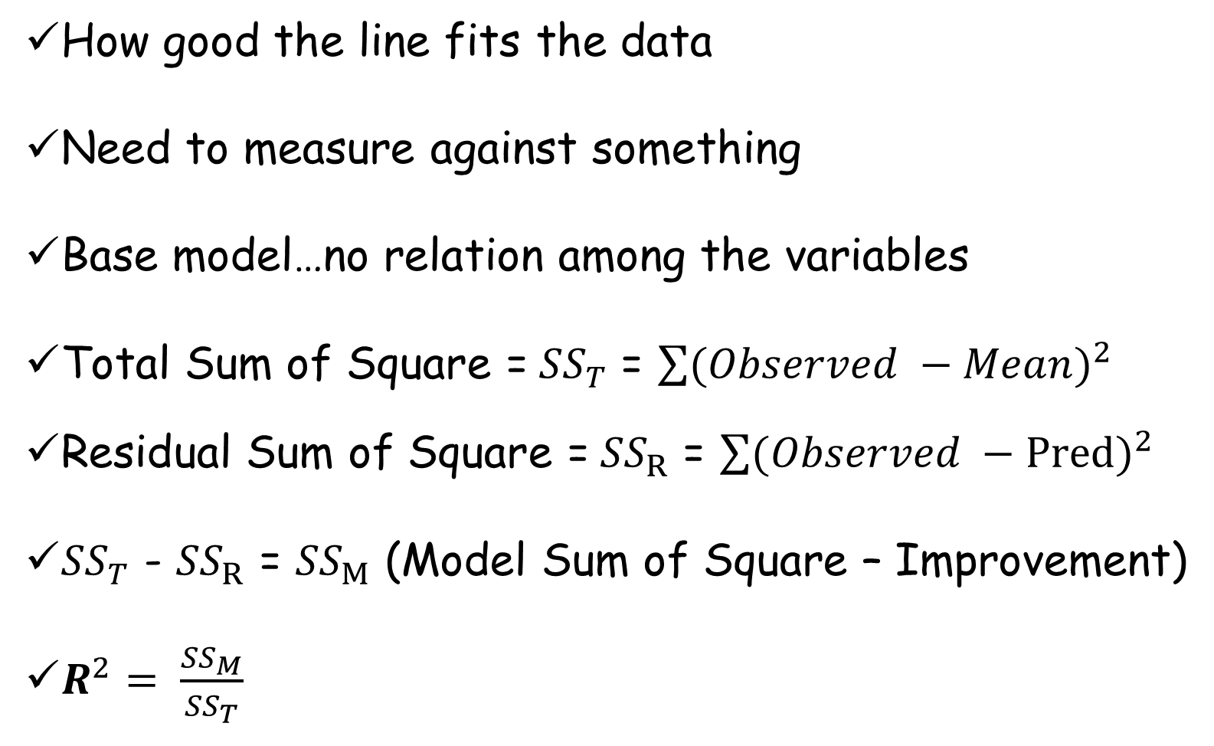

Slide 15

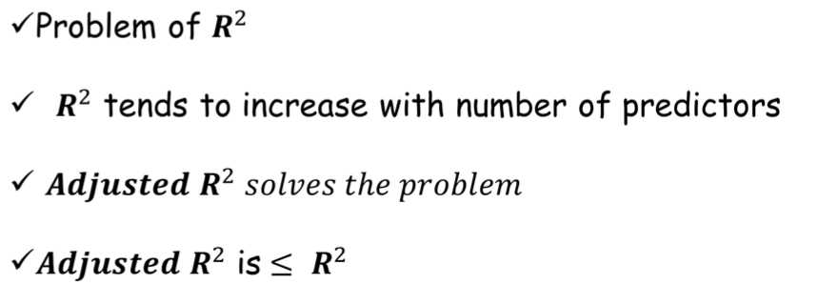

Slide 16
Model output and validation.. ANOVA

Slide 17


Slide 18


Slide 19

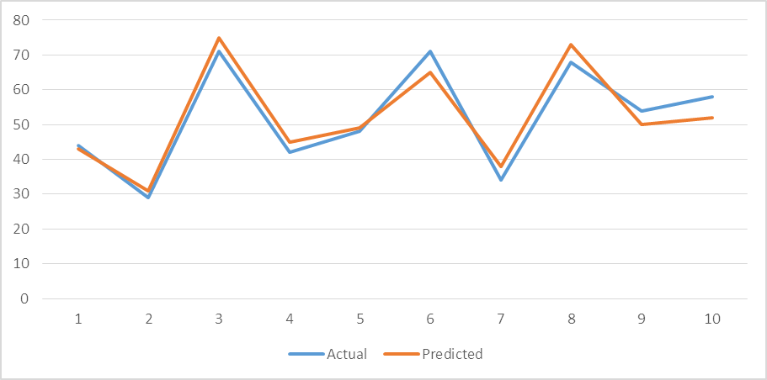

Slide 20
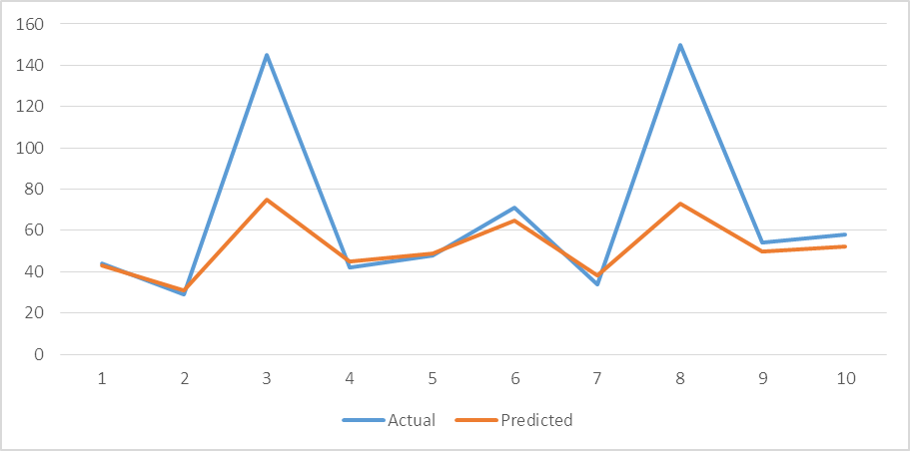

Slide 21

Mean Absolute Percentage Error
How different the predictions are from the actual
Ranges from 0 to 1
Lesser the MAPE better the model is

Slide 22
Assumption Diagnostics!
Normality
Multicollinearity
Homoscedasticity
Serial Correlation

Slide 23
Assumption Diagnostics.. Normality!
The errors should be normally distributed
How to test:
Test the residuals for a normality test..the p value should be more than 0.05

Slide 24
Assumption Diagnostics.. Multicollinearity!
There should be no perfect linear relationship between two or more of the predictors
How to test:
Test with VIF, or TOL. Lower the VIF better off the model is

Slide 25
Assumption Diagnostics.. Homoscedasticity!
At each level of the predictor variable(s) the variance of the residual terms should be constant
How to test:
Visual inspection of residuals
Breusch-Pagan Test; p value should be more than 0.05
Cook-Weisberg test; p value should be more than 0.05

Slide 26
Assumption Diagnostics.. Serial Correlation!
For any two observations the residual terms should be uncorrelated (or independent).
How to test:
Durbin–Watson test; Ranges from 0 – 4
Value close to 2 means the residuals are uncorrelated
Value away from 2 means the residuals are correlated

Slide 27




Visit Ivy’s Blog for Career Tips, Latest Info, Job Alerts - www.ivyproschool.com/blog
Interact with us at -
Ivy Professional School
14 B | Camac Street | Kolkata – 17 www.ivyproschool.com | info@ivyproschool.com T: 033 400 11221 | SMS: 9748 441111

